Slide 1


SPRINT 2 PLAYBACK / TEAM 74
OAPA Academy
Moodle Framework
A working, reusable learner journey built inside the OAPA Academy
OAPA already had Moodle, but future courses still needed a consistent structure, progression model and assessment flow. Sprint 2 turned the validated Sprint 1 design into a working Core MVP that content experts can reuse instead of rebuilding the learner experience each time.
ARYAN RAJENDRA
PROJECT MANAGER
01 / PROJECT OVERVIEW

Slide 2
02 / ORIGINAL PLAN
Sprint 2: Core MVP
The baseline against which delivery is measured
SPRINT 2 GOAL
Implement one representative reusable OAPA learner journey end to end in the new Academy.
CORE BUILD
LEARNER FLOW
ASSESSMENT & TRACKING
REUSE & QUALITY
Course Home
Modules 1–3
Workshops 1–3
Assessment area
Sequential completion
Visible progress
Locked/unlocked states
2-of-3 workshop eligibility
Soft feedback stage
Revision to final submission
Grade visibility / extensions
Completion & reporting
Content-expert reuse
Student/Teacher evidence
UX & accessibility review
Admin handover path
Sprint 2 was the build sprint: the target was a rough but genuinely functional Core MVP, not another prototype.
02 / ORIGINAL PLAN

Slide 3
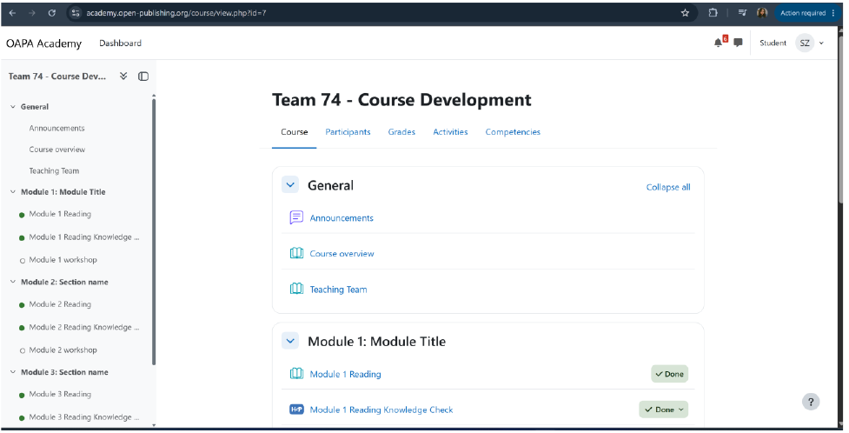
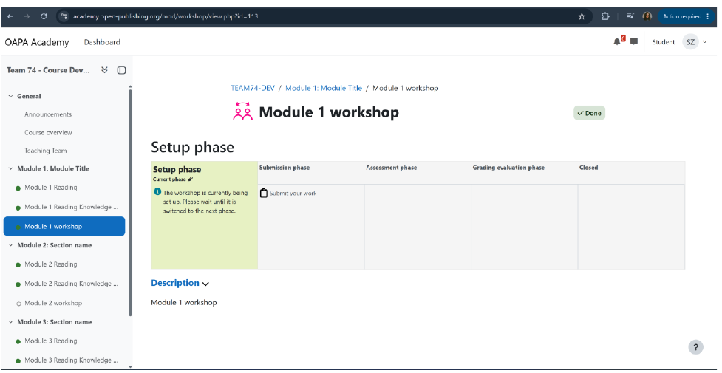
03A / ACTUAL ACHIEVEMENT
End-to-end learner flow works in the deployed OAPA Academy
Course Home → sequential Modules 1–3 → visible completion/locking → workshop progression
PROOF 01 / COURSE HOME + PROGRESSION
PROOF 02 / WORKSHOP PROGRESSION
LIVE OAPA EVIDENCE
Student view in academy.open-publishing.org / sequential progression and Done states visible / workshop step running inside the same course
03A / ACTUAL ACHIEVEMENT

Slide 4
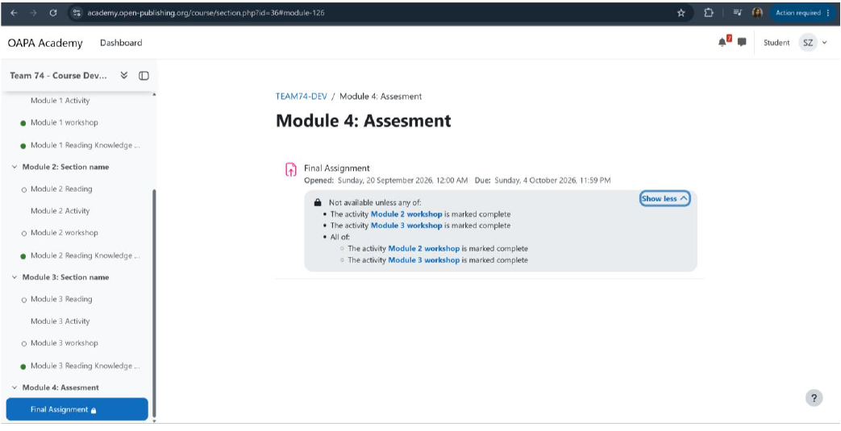
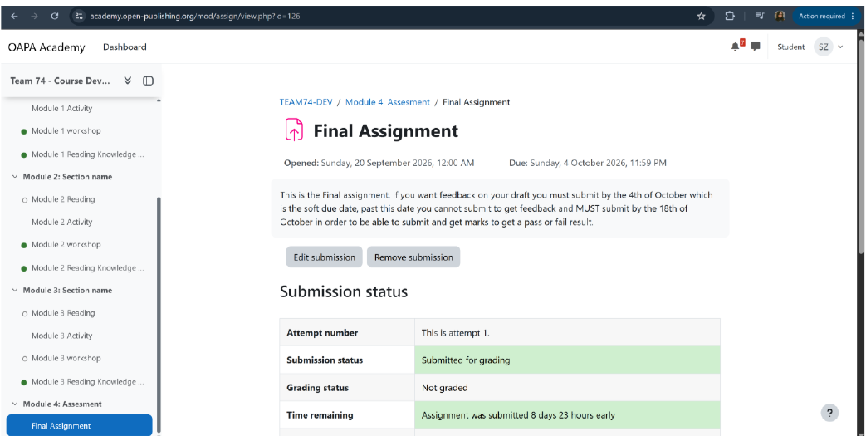
03B / ACTUAL ACHIEVEMENT
The real business workflow works
Any 2 of 3 workshops → Final Assignment unlocks → soft feedback/revision → final submission
PROOF 03 / 1 WORKSHOP = ASSESSMENT LOCKED
PROOF 04 / 2 WORKSHOPS = ASSESSMENT UNLOCKED
BUSINESS RULE VERIFIED
1 workshop = locked / 2 workshops = unlocked / formative submission remains stored as Submitted for grading
03B / ACTUAL ACHIEVEMENT

Slide 5
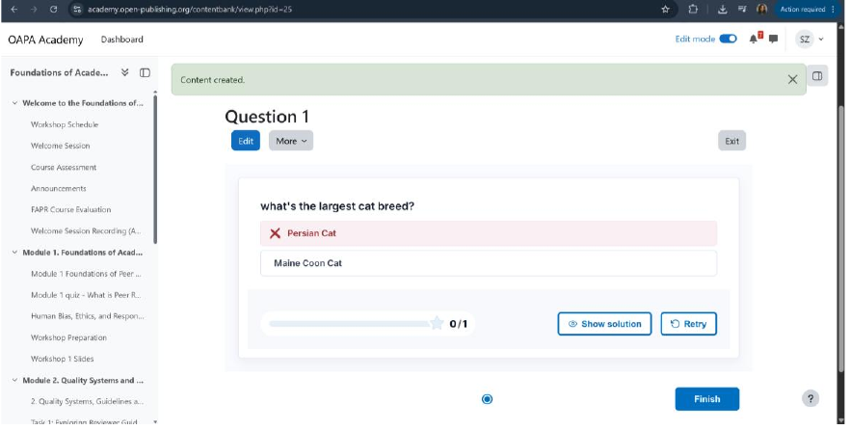
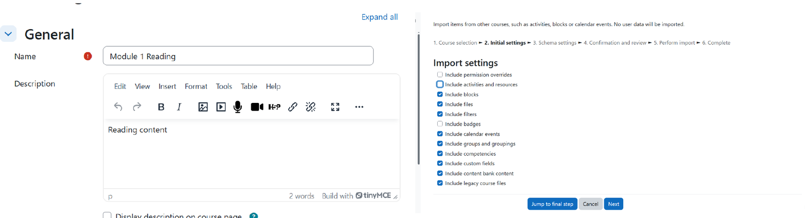
03C / ACTUAL ACHIEVEMENT
Reusable interactivity and framework work
H5P Question Set works in OAPA Academy + native Quiz fallback + reusable, editable course structure
PROOF 05 / H5P QUESTION SET IN OAPA ACADEMY
PROOF 06 / CONTENT EDIT + IMPORT / REUSE
REUSABLE INTERACTIVITY + FRAMEWORK
H5P creates, renders and checks answers in OAPA Academy / native Quiz fallback retained / template content can be edited and imported without rebuilding learner logic
03C / ACTUAL ACHIEVEMENT

Slide 6
04 / WHY IT MATTERS
One tested framework, reused across future OAPA courses
1
MANY
REUSE
FUTURE COURSES
MASTER
FRAMEWORK
COURSE A
COURSE B
COURSE C
Content experts
replace content
Core rules
stay preconfigured
Structure adapts
without rebuild
OAPA can now reuse a preconfigured learner flow instead of redesigning progression, eligibility, assessment and tracking for every course. Learners get a predictable path; content experts focus on content rather than rebuilding Moodle logic.
04 / CLIENT VALUE

Slide 7
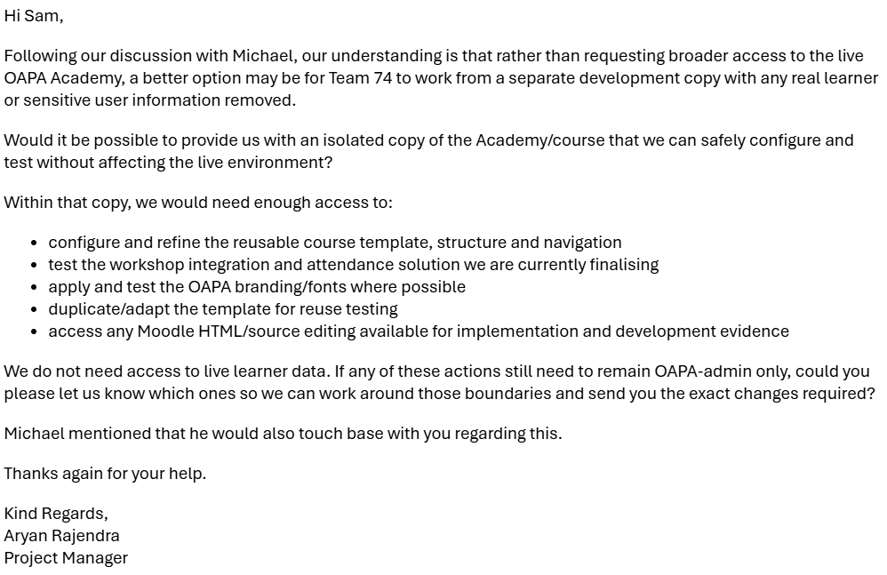
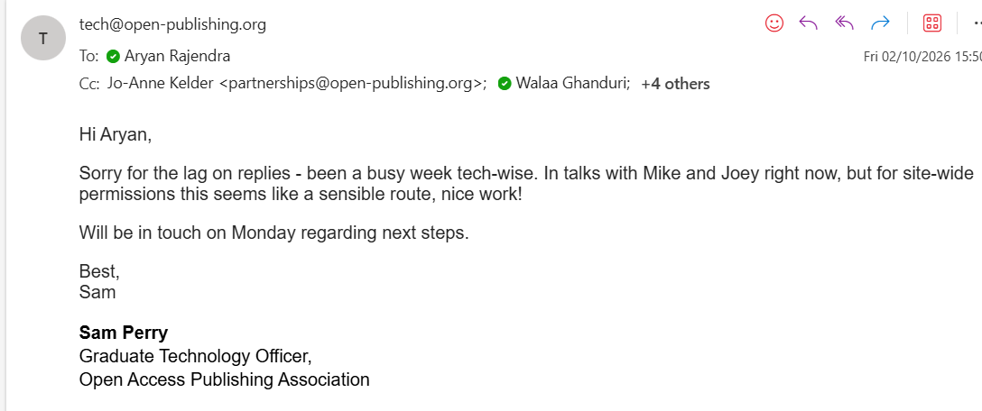
05 / BLOCKERS & OPEN QUESTIONS
The remaining blocker is environment-level, not Core MVP logic
CURRENT BLOCKER
BLOCKER EVIDENCE
Team 74 still needs an isolated Academy copy with the site-level capability required to finish the remaining integration and visual changes safely, without touching live learner data.
Our response
We requested a sanitised development copy from Sam. Michael said he will also follow up with Sam. Course-level implementation is complete where current Teacher access permits; the blocked items resume as soon as the copy/permissions arrive.
ACCESS COPY / SITE-LEVEL PERMISSIONS / PENDING MONDAY
OPEN IMPLEMENTATION ITEMS
Teams workshop integration + verified attendance
/ OAPA fonts & branding / site-level navigation
and accessibility refinements
05 / BLOCKERS & OPEN QUESTIONS

Slide 8
06 / TASK ALLOCATION & TIME
60 logged team-hours across the Sprint 2 Core MVP
20
20
20
TEAM-HOURS
TEAM-HOURS
TEAM-HOURS
WEEK 1 / COMPLETED
WEEK 2 / COMPLETED
WEEK 3 / COMPLETED
Member | Role | Sprint 2 task groups | Hours | Status
Aryan Rajendra | PM | T31–32 planning/governance T41–42 review/escalation T51–52 closeout/playback | 12 h | Complete
Riley Pittard | BA | T33–34 acceptance/decisions T43–44 validation/workflows T53–54 final acceptance/gaps | 12 h | Complete
Walaa Ghanduri | UX | T35–36 UX handoff/feasibility T45–46 build/accessibility review T55–56 final UX/brand handover | 12 h | Complete
Reshan Lahandapura | Dev 1 | T37–38 reusable shell/progression T47–48 workshop/assessment T57–58 fixes/reuse handover | 12 h | Complete
Shaikh Zarin Tasnim | Dev 2 | T39–40 interactivity/cross-test T49–50 tracking/edge cases T59–60 regression/quality closeout | 12 h | Complete
Planner / CRM control: 4 hours per member per week × 3 weeks = 12 hours each. Every Sprint 2 week retained the 20 team-hour allocation.
06 / ALLOCATION & TIME

Slide 9
07A / SPRINT 2 TIMELINE
Sprint 2 formal meetings and advisor coverage — Weeks 1–2
15 SEP
17 SEP
17 SEP
22 SEP
24 SEP
Internal team meeting
Client meeting
Vic dual-role review
Internal team meeting
Client build review
1 hour - Reviewed the Core MVP build sequence, Planner progress, access needs and evidence expectations.
17m 29s - Reviewed implementation progress, developer access requirements and remaining OAPA-side dependencies.
24 min - Weekly session covered both technical-advisor and supervisor review of progress, blockers and next actions.
1 hour - Aligned BA, UX and Development work, evidence sharing and exact blocker escalation for Week 2.
20 min - Confirmed Teams workshops, 2-of-3 eligibility, flexible progression and the soft-to-final assessment flow.
ADVISOR COVERAGE
SUPPORTING COMMS
Vic is both Team 74’s supervisor and technical advisor, so the weekly Vic sessions covered both roles. On 24 Sep no session was required because no technical/supervisor questions were open, and the PM informed Vic. On 2 Sep the PM emailed non-technical advisor Leon that no non-technical blockers had arisen and asked whether a session was still needed.
16 SEP / Sam created Team 74 dev course
23–25 SEP / H5P, attendance + branding follow-ups
07A / SPRINT 2 TIMELINE

Slide 10
07B / CLOSEOUT & NEXT STEPS
Sprint 2 closeout meetings and the Sprint 3 commitment
01 OCT
01 OCT
02 OCT
03 OCT
MONDAY
Client closeout meeting
Vic - dual-role review
Internal team meeting
Access-copy follow-up
Expected access step
1h 09m - Reviewed development evidence, remaining implementation, access constraints and the isolated-copy route.
30 min - Supervisor + technical-advisor session reviewed Sprint 2 closeout, blockers and the Sprint 3 direction.
42 min - Reconciled the specification, workshop integration, access needs, role boundaries and Sprint 3 plan.
Client-supported route: request an isolated Academy copy with the site-level capability needed for blocked work.
Receive the isolated Academy copy / required permissions, then complete the remaining site-level implementation.
SPRINT 3 / REFINE MVP
STARTING POSITION
Finish the live workshop + verified-attendance path into Month 4 assessment eligibility, implement OAPA branding/fonts, and finalise navigation and accessibility. Then regression-test, document the reuse/admin handoff and complete final OAPA handover.
all non-access-blocked Sprint 2 work complete
isolated copy + site-level capability expected Monday
07B / CLOSEOUT & NEXT STEPS

Slide 11
Business Analysis – Acceptance Review and Handover
Contributions
Primary Blocker
01
Existing test accounts already had passing scores
This prevented the team from proving the module gates blocked fresh learner
I kept those checks partially validated and identified fresh learner tests for follow-up
Requirements and workflow
Defined progression, attendance eligibility and both assessment routes
02
Final acceptance review
Reviewed team evidence against 16 criteria and recorded validation gaps
03
Sprint 3 priorities
Prioritised 18 gaps with owners and outcomes, while preserving Core MVP scope.

Slide 12



UX Design – OAPA Academy
OAPA branding
Navigation and Course structure
Mock-up solutions for the problems

Slide 13
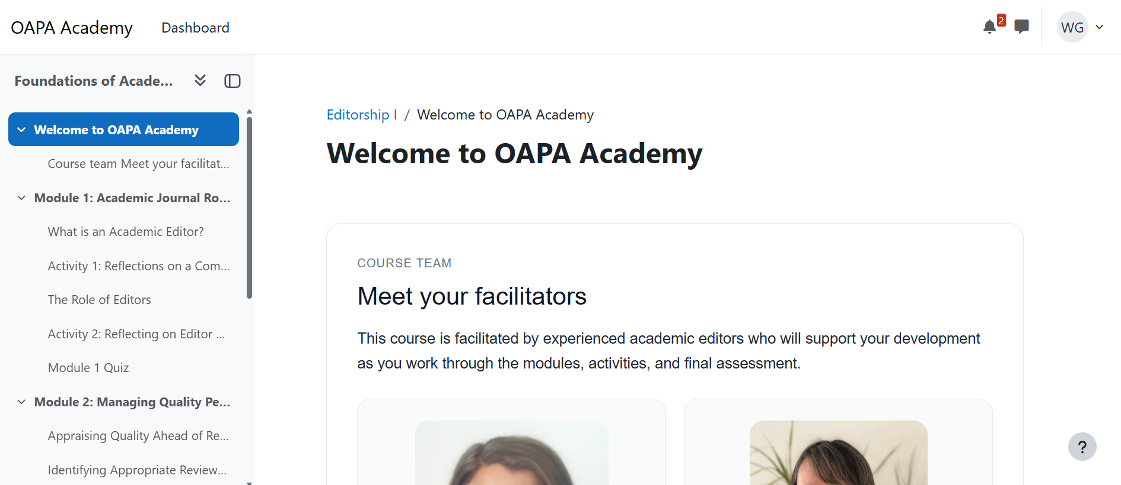
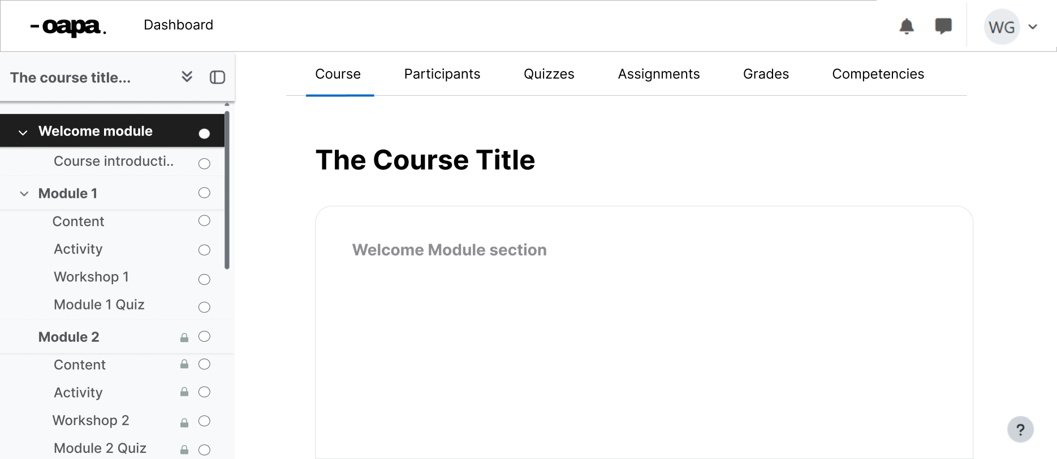
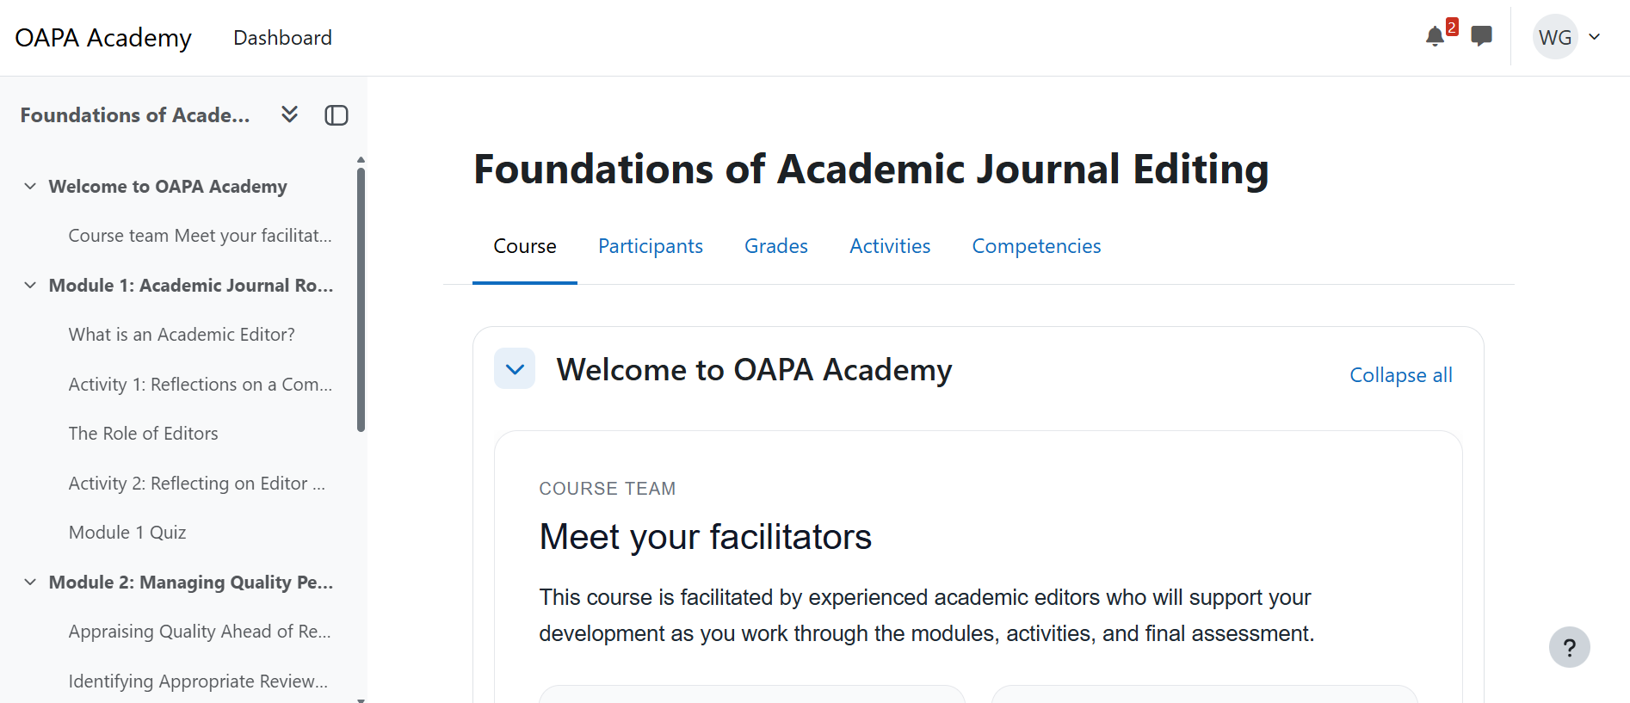
OAPA Landing Page
The landing page mock-up
The landing page in the platform

Slide 14
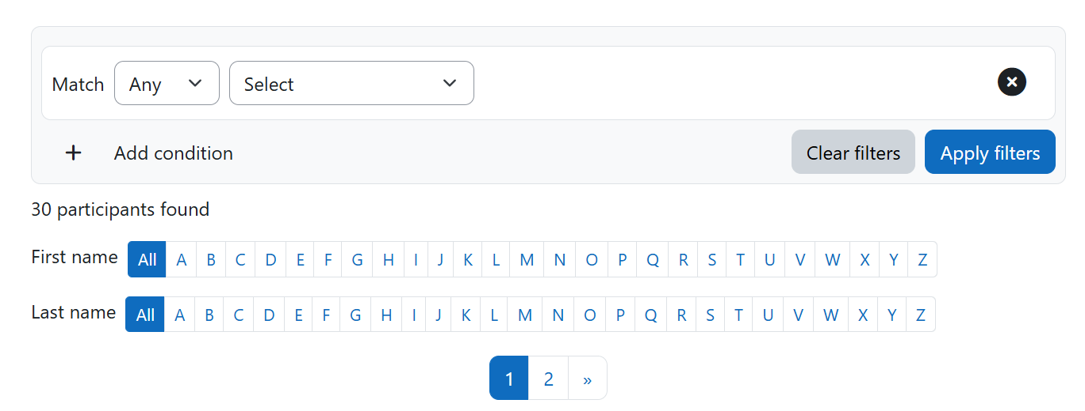
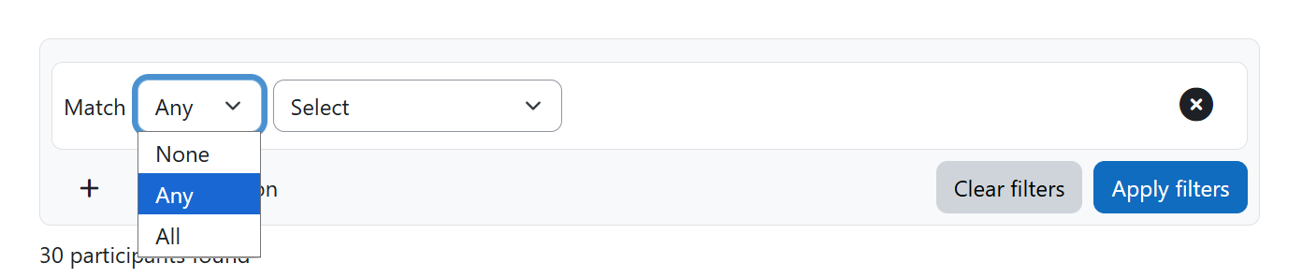
The Participants Tab

Slide 15
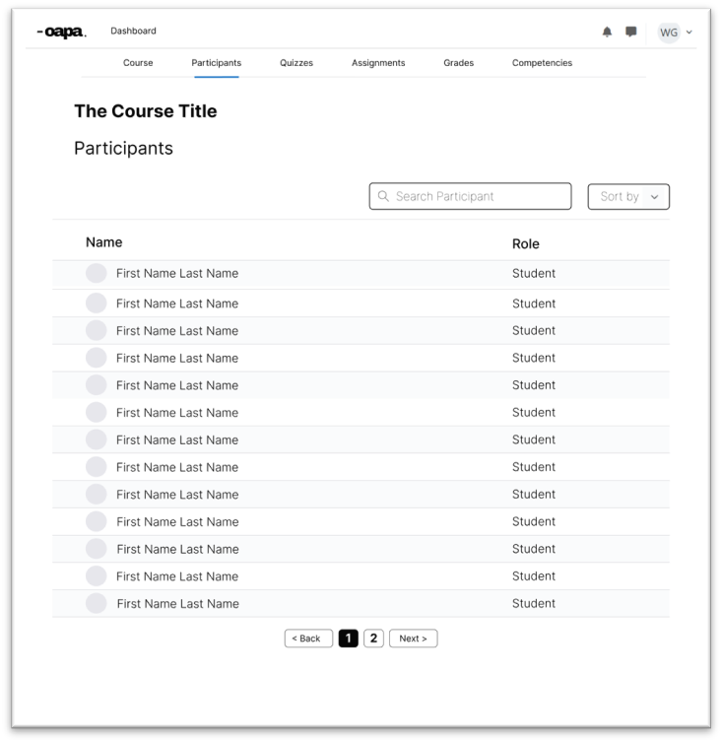
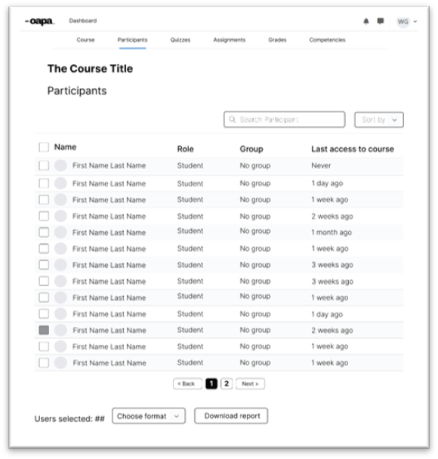
The Participants Tab
The user perspective
The facilitator perspective

Slide 16
UX Sprint 2 blockers
The feasibility misalignment

Slide 17
DEVELOPER 1 - Reshan
What I Did
Implementation of workshop
requirements
Re-Usable Course Template
Implementation
UX review defect fixing
Personal Blocker
No code access not allowing development of branding book required changes
10 / DEVELOPER 1

Slide 18
SHAIKH ZARIN TASNIM
What I contributed
Developer 2
TEST
Walked through the course as a student multiple times, catching real issues like an undisclosed 100% pass-mark requirement
Sprint 2
OAPA Editor Academy
Moodle Platform
BUILD
When H5P was blocked by a missing library, built the self-check quizzes on Moodle's native quiz tool instead, six question types with full feedback
TRACK
Verified that grades, completion and workshop tracking were accurate, for both students and staff
CLOSE
Closed the sprint by confirming H5P's missing library is finally fixed, giving the course two working self-check options
Blocker & learning
Blocker: H5P, the interactive quiz tool, stayed broken for most of the sprint, with no timeline on when admin access would fix it.
Learning: building a working alternative first, instead of waiting on a permission we didn't control, kept the sprint moving and ended up being the stronger option anyway.
Team 74

Slide 19
Wrap Up
That Wraps up our Sprint Playback Presentation

